Slide 1
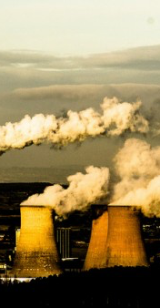
Climate changes effects on future air quality
Air resources management seminar - 12/3/2019

Slide 2
What we'll talk about today...
(not so short...) Introduction –
How do air pollutants affect climate?
What are the expected climate changes by the end of the century?
How do we estimate the effects of climate changes on pollutants concentrations?
General review of results - how does climate affect air pollutants?
Case study – review of a research paper
Relations to air quality management - Discussion
Summary & Conclusions

Slide 3
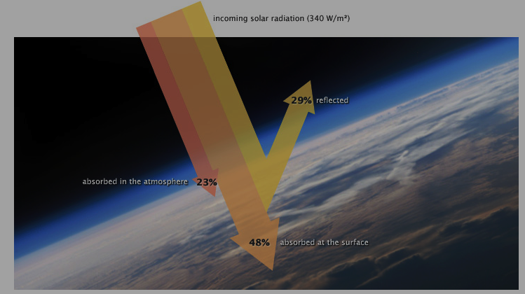
Air pollution effect on climate
Climate change is driven by air pollution
Earth’s surface temperature is determined by the balance between incoming solar radiation and outgoing infrared radiation
Air pollutant sources emit greenhouse gases (GHG) or particles
Earth’s energy balance is disturbed when these air pollutants interact with solar and terrestrial radiation, leading to changes in earth’s surface temperature and in climate
NASA's Earth Observatory
Introduction

Slide 4
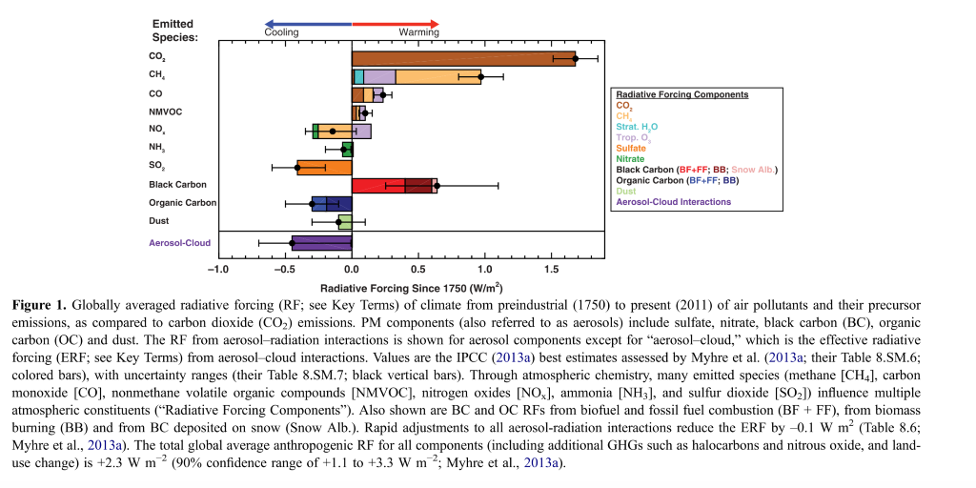
Air pollution effect on climate
[ Mechanisms by which air pollutants affect climate ]
Radiative forcing (RF) - a measure of the influence a certain pollutant has on the climate system
GHG and particles can induce different RF effects, depending on their atmospheric concentration, warming or cooling capacity (how well they absorb IR radiation), residence time and spatial distribution in the atmosphere.
High uncertainty
Fiore et al., 2015
Introduction

Slide 5
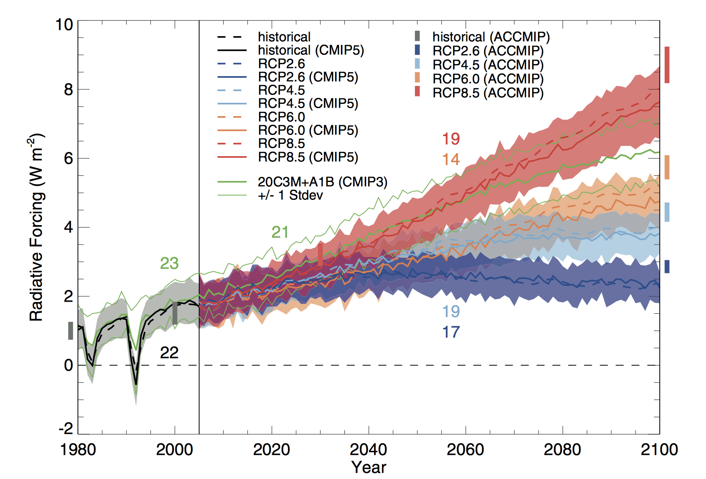
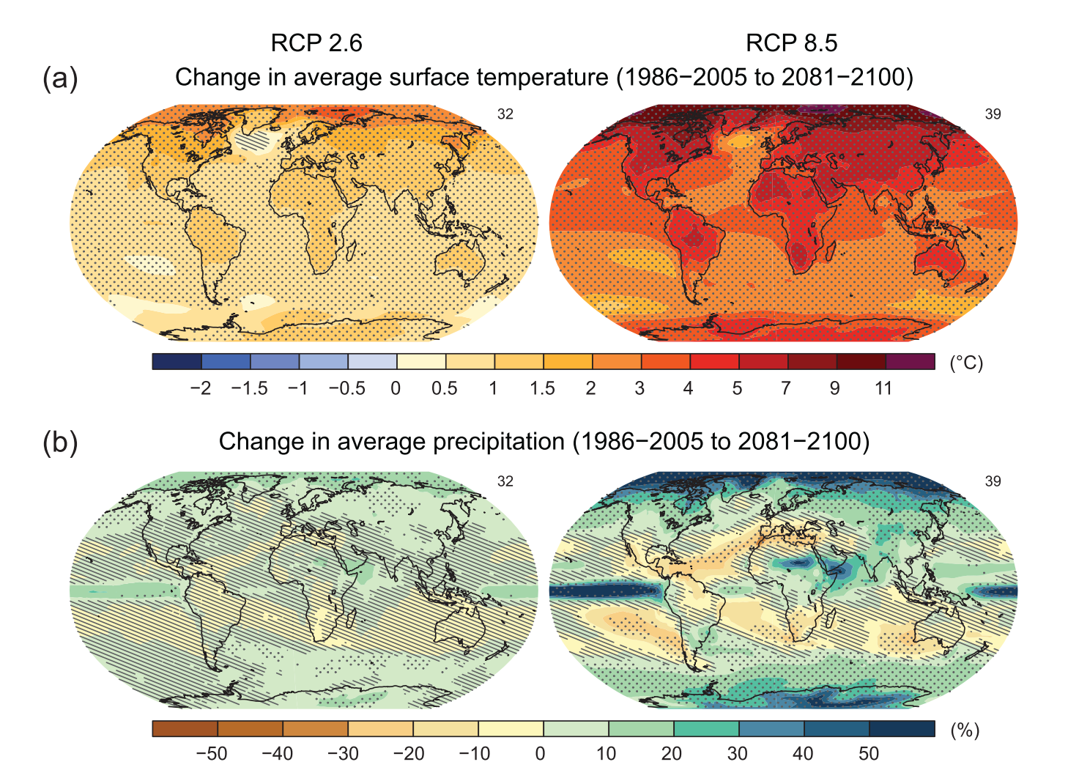
Expected climate changes
Temperature raise
Other relevant changes: changes in precipitation patterns, humidity and water vapor raise, cloud cover, weaker global circulation and decrease in frequency of mid-latitude cyclones, extreme events – heat waves, droughts and wildfires
Emission scenarios: SRES – Special Report on Emission Scenarios, RCP – Representative Concentration Pathways (2014)
NASA's Earth Observatory
IPCC report, 2013
Introduction
Notes:
שינוי בטמפ ובדפוס המשקעים אי ודאות מאוד גדולה. אין מקומות שלא מתחממים. , חלק מהמקומות נעשים יותר רטובים וחלק יותר יבשים.
מדברים על יותר גלי חום בכל המקומות, בחלק מהמקומות המשקעים גדלים בגלל אידוי מוגבר מהאוקיינוסים אבל משתנה.. שינויי לחות (ספציפית) ועננות בערך עוקבים אחרי
השינויים במשקעים. . .
ב2014 ה
SRES
הוחלף ב
RCP
אגב הייתה ביקורת על הפרוג'קשיינס האלו שהם לא לוקחים בחשבון הידלדלות במשאבים של דלקים פוסיליים

Slide 6
Relevant pollutants
Surface Ozone (O₃) -
Ozone is produced in the troposphere by photochemical oxidation of CO, CH4, NMVOCs by OH in the presence of reactive nitrogen oxides (NOx = NO + NO2).
The hydroxyl radical originates mainly from atmospheric oxidation of water vapor by excited oxygen atoms O(¹D), which itself is produced by a photochemical reaction - absorption of solar ultraviolet radiation of wavelength shorter than 320 nm by ozone
O3 + hv --> O2 +O(1D)
O(1D) + H2O --> 2OH
Sources of the precursors
Usually a summer problem (photochemical process), usually limited by supply of HOx and NOx
Sinks: photolysis in the presence of water vapor, uptake by vegetation (dry deposition), wet deposition is negligible
Background Ozone
PM-
Sulfate, nitrate, OC – are produced by oxidation of SO2, NOx and NMVOCs.
Other - BC, soil dust, sea salt
All year round problem
Lifetime is similar to ozone, background is negligible
Sinks: wet deposition
Introduction
Notes:
למה זה בעיה עולמית - זמן חיים ומעבר בין מקומות

Slide 7
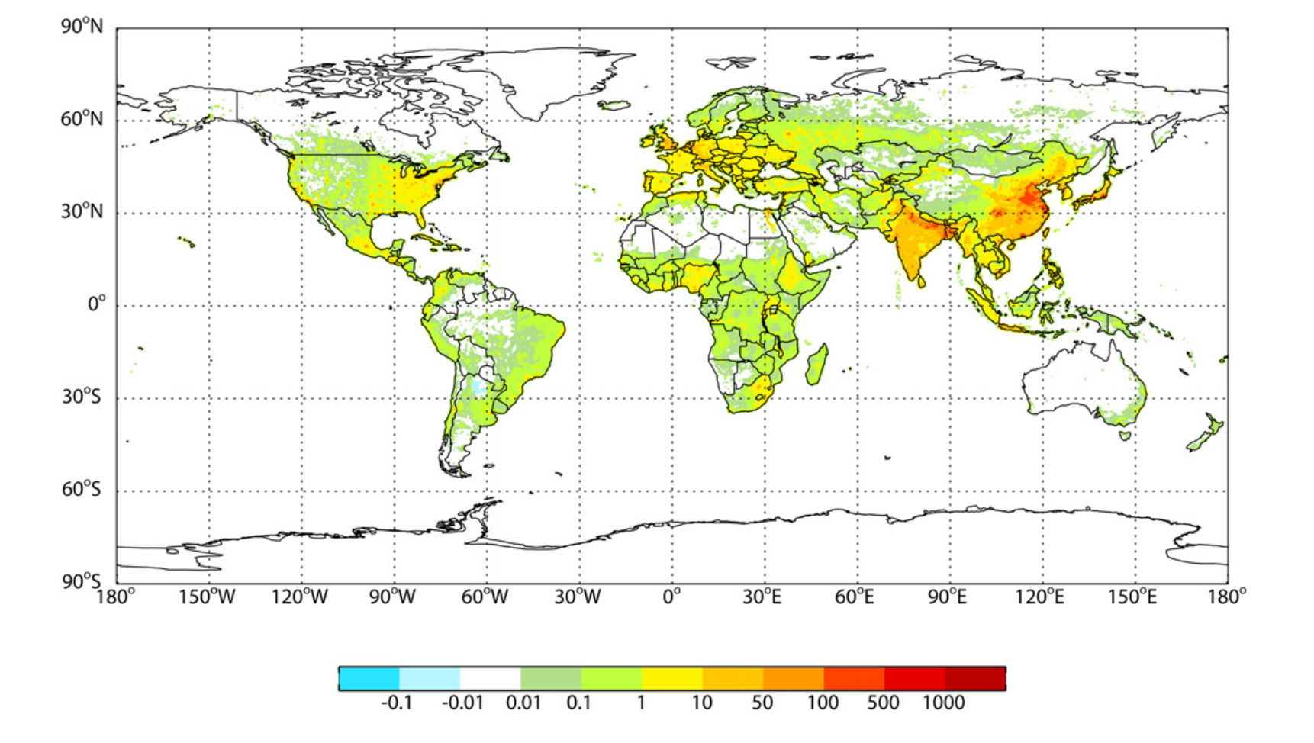
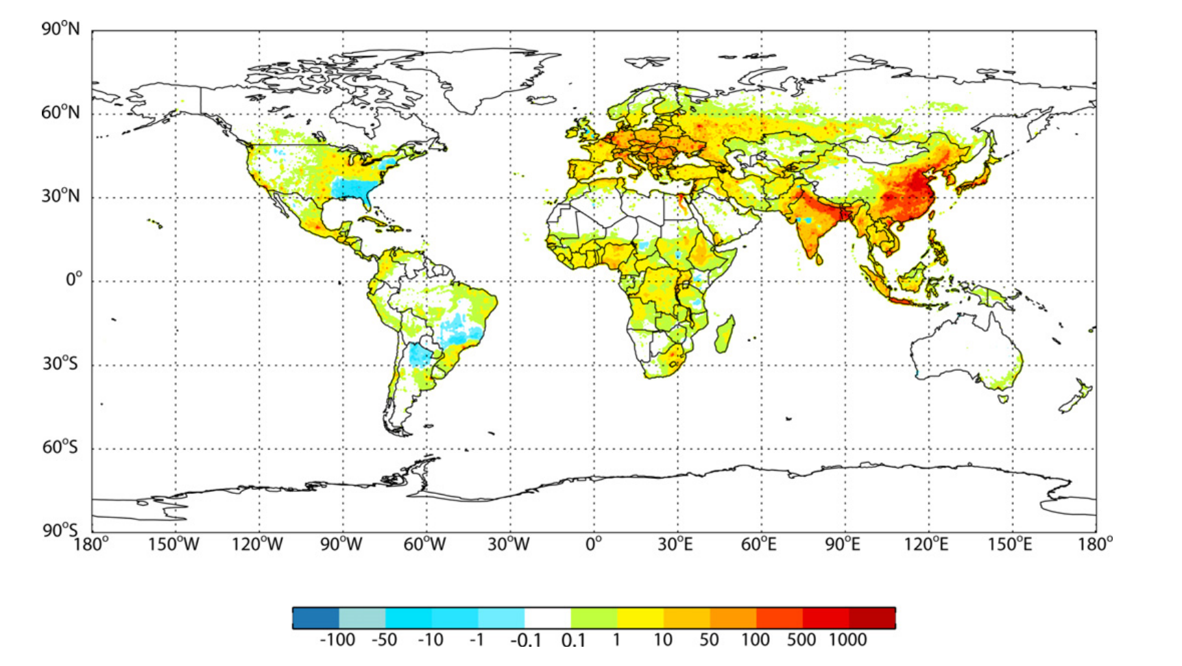
Relevant pollutants
Why ozone and PM?
Important climate forcing agents
Most widespread violations of the Air Quality Standards
Great health impact – WHO estimates: 4.2 million premature deaths globally are linked to ambient air pollution, mainly from heart disease, stroke, chronic obstructive pulmonary disease, lung cancer, and acute respiratory infections in children
Strongest evidence for concern – PM, O3, NO2, SO2
Silva, 2013. Current premature mortality due to anthropogenic air pollution (2000–1850), in deaths yr⁻¹ (1000 km²)⁻¹, for (top) ozone and (bottom) PM2.5
Introduction
Notes:
למה זה בעיה עולמית - זמן חיים ומעבר בין מקומות

Slide 8
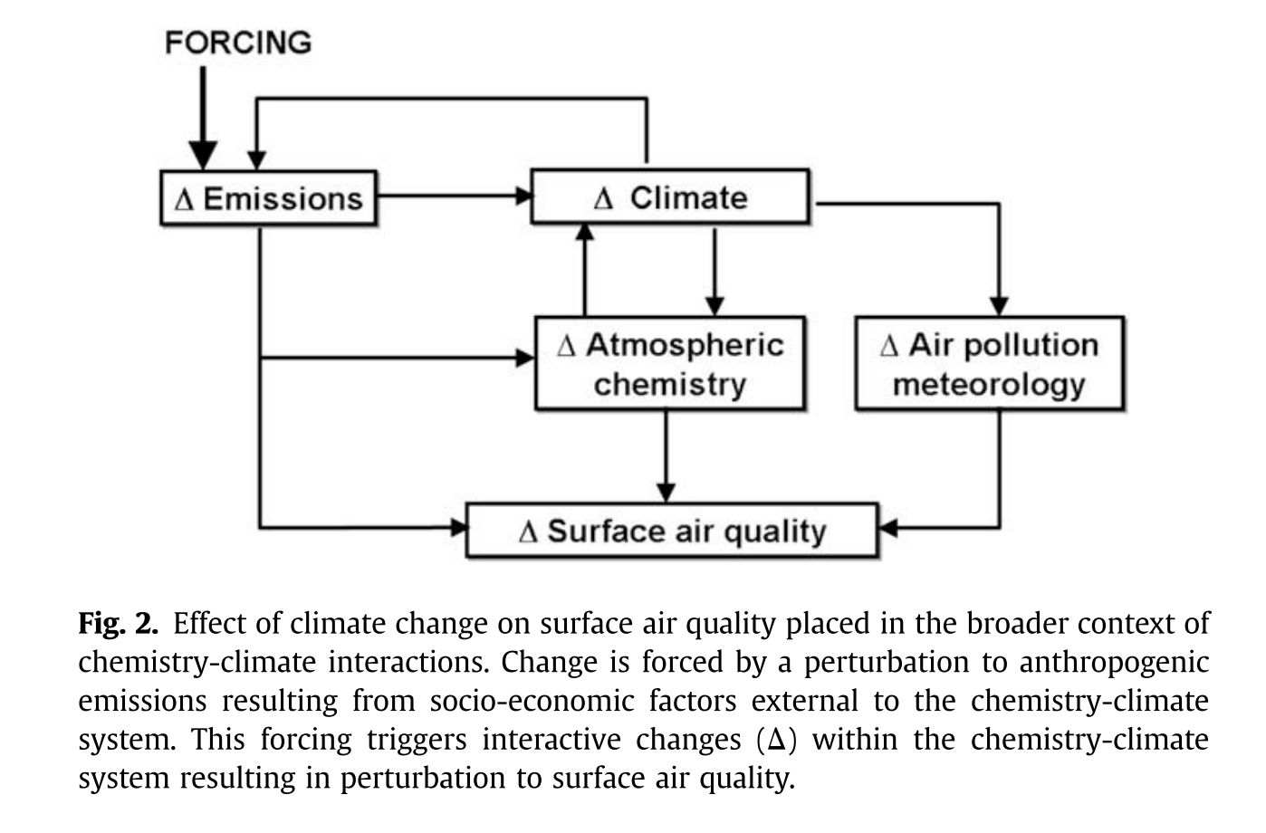
Climate affect on Ozone and PM (broader context)
Changes in climate affect air quality by:
Changing ventilation rates (wind speed, mixing depth, convection, frontal passages...)
Changing precipitation patterns
Changing dry deposition rates
Changing natural emission rates
Changing chemical production and loss rates
Changing background concentrations
Natural emissions
ΔCO2
Ozone
PM
ΔNOx
Ozone
PM
Jacob and winner, 2009.
Introduction
Notes:
בדיאגרמה אפשר לראות שגורם מאלץ חיצוני (כמו האדם) יוצר שינויים בפליטות, למשל פליטות של CO2, גורמים לשינויי אקלים, שמשפיעים על הכימיה האטמוספירית, והכימיה האטמוספירית משפיעה חזרה גם על האקלים וגם על איכות האוויר בקרקע. שינויים באקלים גם משנים את הפליטות הטבעיות של חלק מהמזהמים וגם משפיעים על מטאורולוגיה שקשורה לזיהום אוויר.

Slide 9
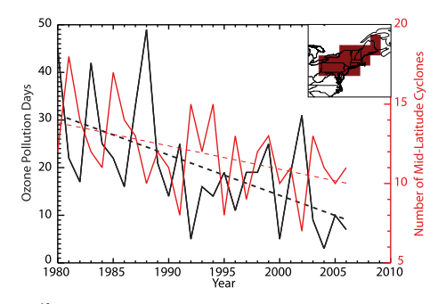
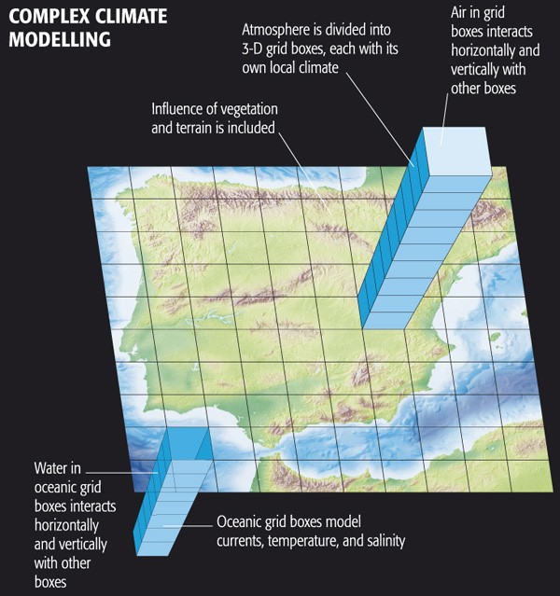
Estimation of climate effects on pollutant concentration
Three main approaches are used:
1. Looking for correlations with meteorological variables (observation based)
2. Using regional chemical transport models (CTMs) with shifted meteorological variables values
3. CTM simulations driven by global climate models (general circulation models/GCMs)
Leibensperger, 2008.
Introduction
Notes:
עבור הגישה הראשונה - רוצים להסיר את האפקט של הוריאביליות במטאורולוגיה כשמסתכלים על מגמות טווח ארוך ואם יודעים את הקורלציות יודעים להגיד מה זה. חוץ מזה פשוט רוצים להבין מה התהליכים שמשפיעים על זיהום אוויר בקרקע.
אז גישה ראשונה זה להסתכל על קורלציות מנתונים קיימים
גישה שניה זה להזיז ולשחק עם פרמטרים מטאורולוגיים ושימוש במודלים כימיים של הסעה כדי לראות את התגובה על ריכוזי המזהמים. לא תמיד התוצאות האלו קונסיסטנטיות עם הקורלציות הנצפות.
גישה שלישית זה לקחת את הפרוג'קשיינס לאקלים העתידי ולראות את ההשפעה על הריכוזים. גם כאן יש חלוקה לעבודות שלוקחות בחשבון רק את השינויים האקלימיים הפיזיים ואלו שלוקחים בחשבון גם שינויי פליטות צפויים.

Slide 10
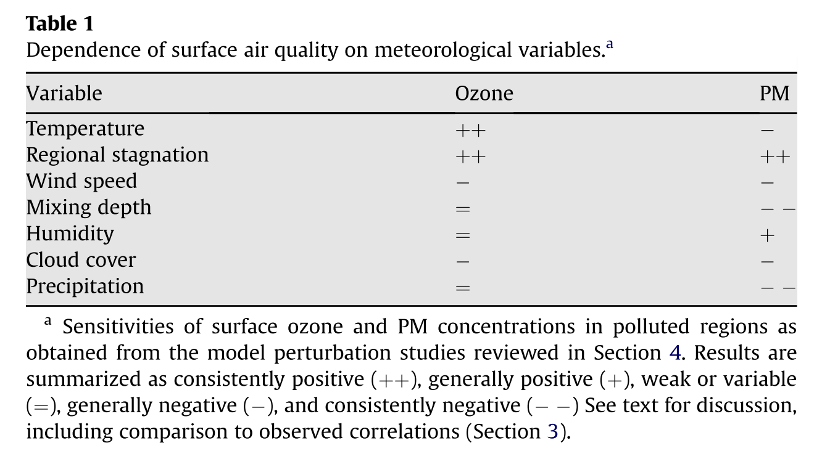
Dependence on meteorological variables (Findings obtained from CTM perturbation studies)
temp. - Highly correlative with high ozone values in polluted areas due to peroxyacetyl-nitrate (PAN) and biogenic isoprene. The effect depend on PM component. Sulfate increase with temp. (faster oxidation of SO₂), nitrate shift from particle phase to gas phase.
Humidity – increase in water vapor increases ozone loss, but can increase its formation under polluted conditions. Drought = less dry deposition. Positive effect – increase PM water content and the uptake of nitrate.
Regional stagnation – cold fronts formed by mid-latitudes cyclones are responsible for pollutant ventilation in North America, Europe and Eastern Asia
Wind speed – weaker wind speed in polluted areas cause ozone to increase due to longer reaction time. Stronger effect on PM because of lower background concentrations
Cloud cover – less clouds, more solar radiation, more surface ozone formation and loss. Little sensitivity.
ventilation
Mixing depth – positive when surface ozone is low, negative when high. Strong diluting effect. Increasing mixing depth is generally associated with decrease in precipitation
Precipitation – Little sensitivity. Wet deposition, frequency rather than rate.
Jacob and winner, 2009.
Ozone PM general
Notes:
לעשות שמש עם הסבר קטן על למה זה משפיע על אוזון ופיאמ

Slide 11
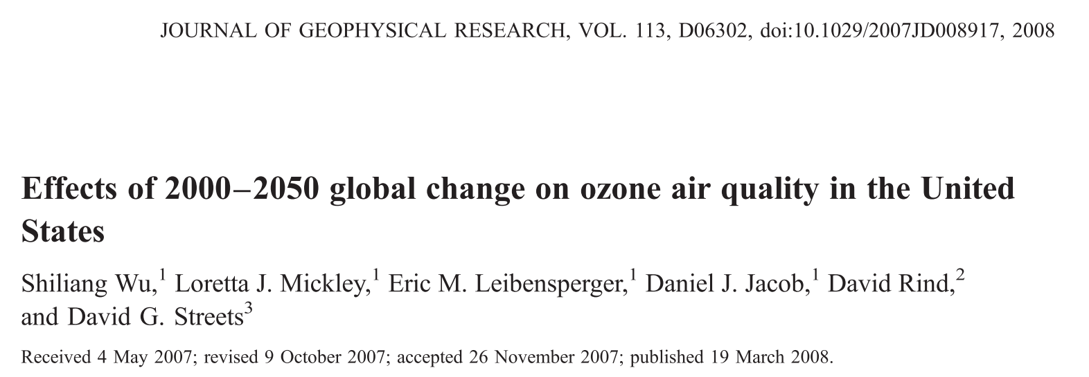
Case study

Slide 12
Methods
Global circulation model - GISS GCM 3 (NASA) – horizontal resolution of 4° latitude by 5° longitude and 23 vertical layers.
Simulation is first calibrated and initialized using past climate.
A1B scenario projection is used for future anthropogenic emissions: rapid economic growth, balanced emphasis on all energy sources. Emissions of ozone precursors increase in developing countries but decrease in North America and Europe.
--> Meteorological output of 6-hour resolution ---> Chemical transport model (GEOS-Chem)
Derive 2000–2050 growth factors for different categories of anthropogenic emissions (fossil fuel, biofuel, and biomass burning) and for different countries, and then apply these factors to the CTM.
Case study - Methods

Slide 13
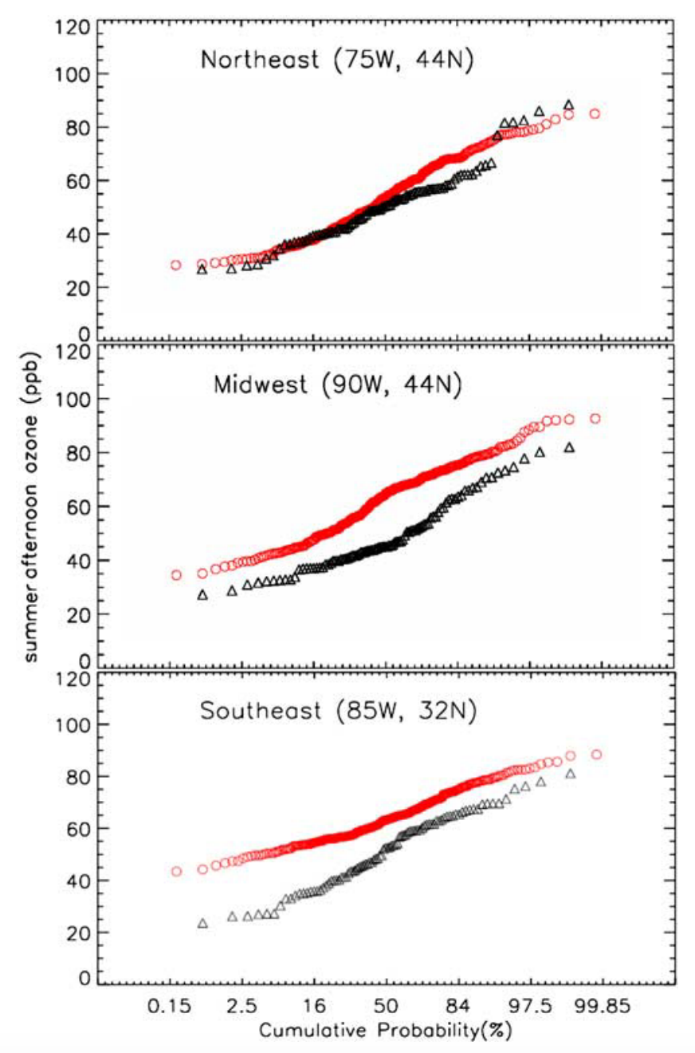
model evaluation
Past evaluation of the model against ozonsonde showed good agreement
Cumulative probability distributions of summer (June–August) afternoon (1300–1700 local time) ozone concentrations in surface air for three representative 4° x 5° model grid squares.
Red circles - model simulation results from three summers of the present-day climate (1999–2001), black triangles are observations.
Overestimation, but reasonable inductive bias of up to 10 ppb.
Wu et al., 2008a
Case study - Results

Slide 14
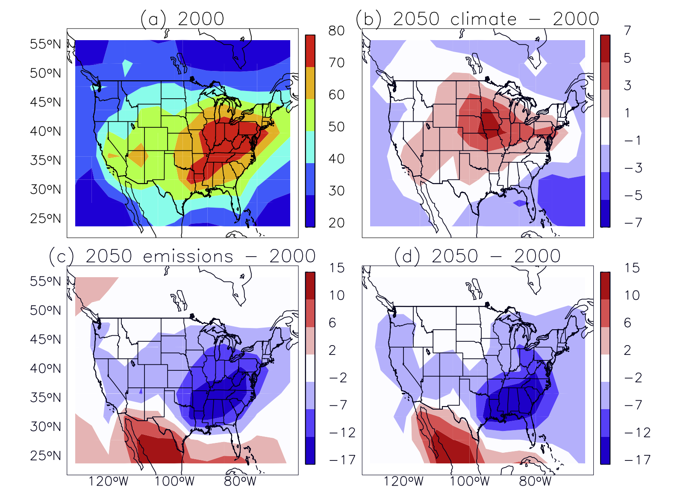
Effect of Global Change on U.S. Ozone Air Quality
only climate change is considered. Anthropogenic emissions of ozone precursors are held at present-day levels. 2–5 ppb increase
2000 conditions ("present day")
2000–2050 changes in anthropogenic emissions alone. 1–5 ppb decrease in the west and 5– 15 ppb in the east
Both climate and emissions
Wu et al., 2008a. Simulated mean daily maximum 8-hour average surface ozone (ppb) in summer (June– August)
Case study - Results

Slide 15
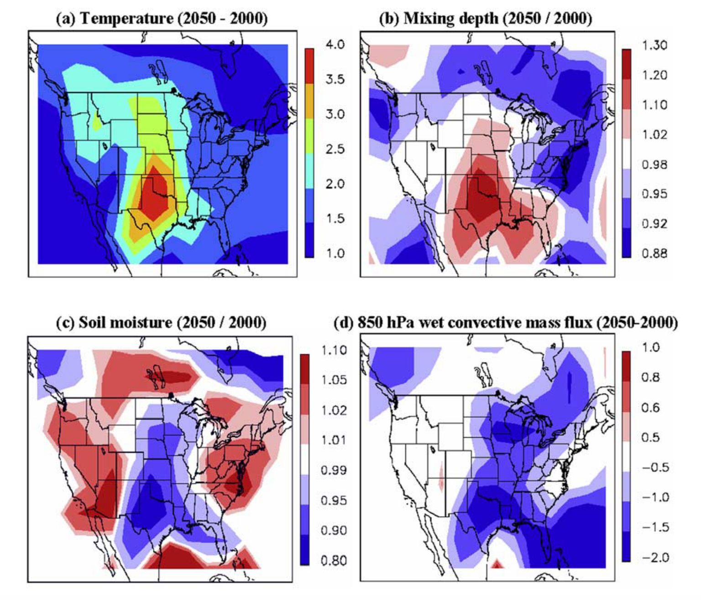
Simulated 2000–2050 changes in summertime air pollution meteorology over the United States (3-month means for June–August 2049–2051 versus 1999–2001):
(a) differences in surface air temperature [ºK]
(b) ratios of afternoon mixing depth
(c) ratios of soil moisture
(d) differences in 850 hPa wet convective mass flux [10⁻³ kg m⁻² s⁻¹ ]
17% decrease in the number of cyclones was found, resulting in less efficient U.S. ventilation.
Conclusion --> The simulated climate-driven ozone increase in the central and northeastern United States reflect a combination of higher temperatures, lower mixing depths, reduced convective ventilation, and more frequent stagnation episodes. The effect of higher temperatures on ozone is partly through increased emission of biogenic isoprene and partly through lower PAN stability.
Wu et al., 2008a. Simulated 2000–2050 changes in summertime air pollution meteorology over the United States
Case study - Results

Slide 16
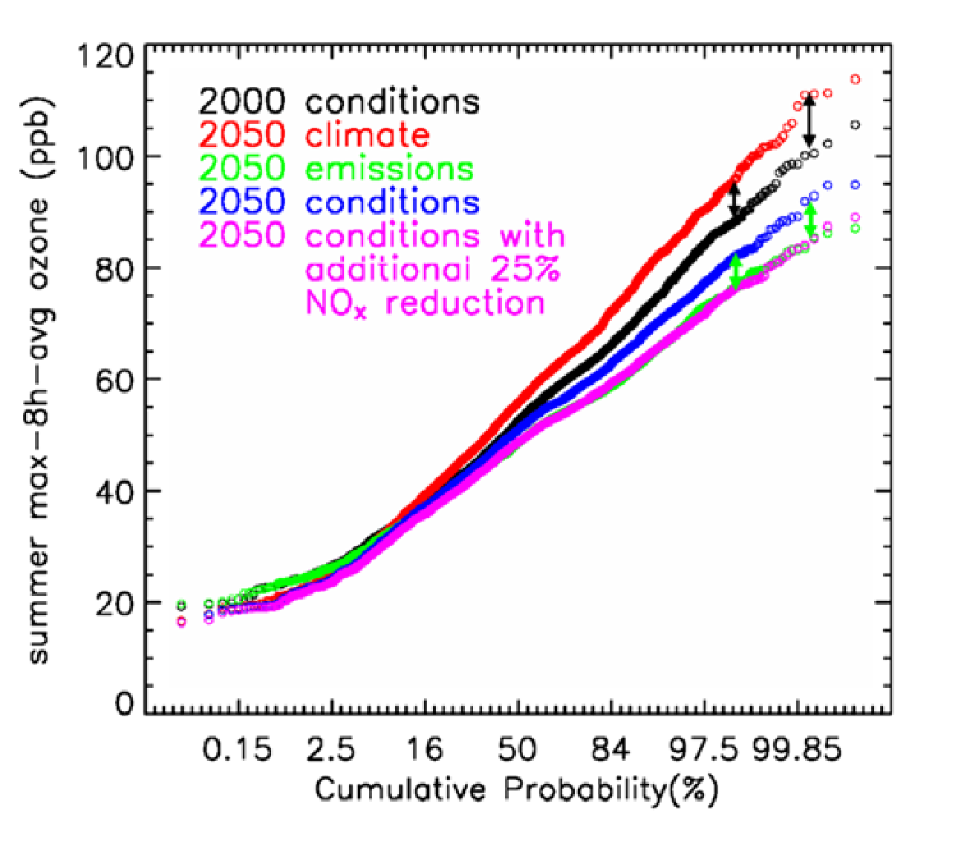
Relations to air quality management
"climate change penalty" - The increase in surface ozone as a result of future climate change offsets the benefits of emission controls to reduce ozone pollution
More stringent emission controls will be required to meet a given ozone air quality target in the future
One can alternatively express the climate change penalty as the amount of additional NOx emission controls that will be required as a result of climate change to attain a given air quality target, considering that NOx is usually the limiting precursor for ozone formation.
For example, if we want anthropogenic emissions to drop by 40% by 2050, we actually need to decrease emissions by 50%.
Wu et al., 2008a
Discussion

Slide 17
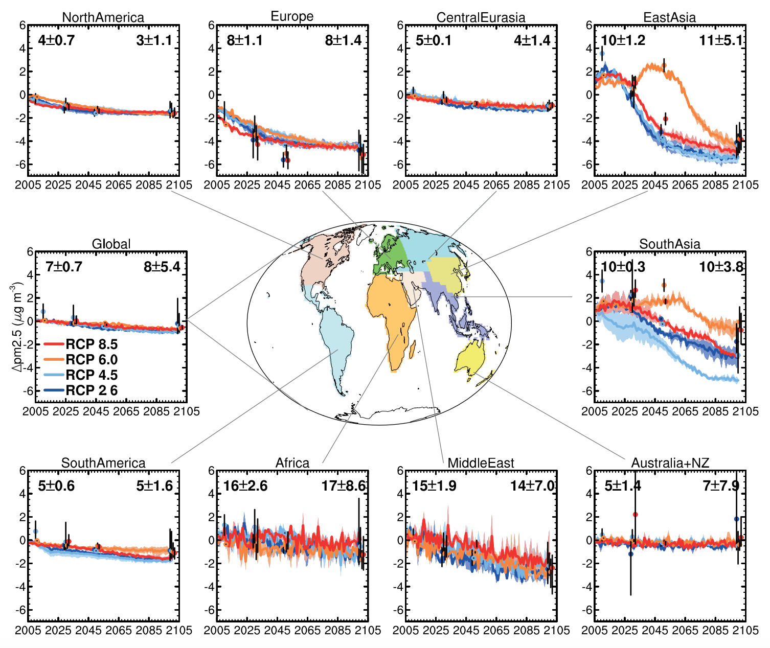
So… how’s it gonna be?
PM concentrations are expected to decrease
Fiore et al., 2012. Projected changes in annual mean surface PM2.5

Slide 18
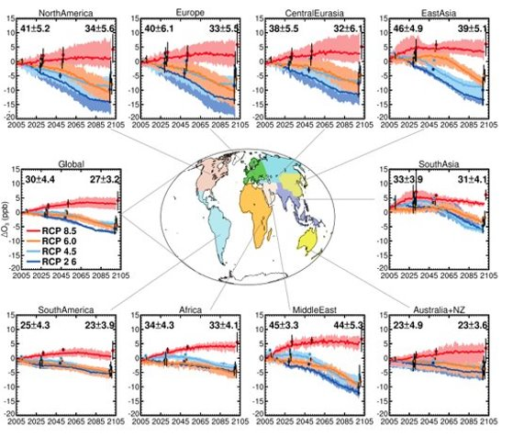
So… how’s it gonna be?
Ozone concentrations are expected to ?
Fiore et al., 2012. Projected changes in annual mean surface Ozone

Slide 19
Summary & Conclusions
Ozone is positively correlated with temperature is regional stagnation. Both are expected to raise in the future and will induce an increase in ozone concentrations forces by climate alone.
Reduction in anthropogenic emissions could “offset” the increase.
PM is positively correlated with regional stagnation but negatively correlated with precipitation and mixing depth (high uncertainty of the expected change).
Along with reduction in anthropogenic emissions, PM levels are expected to decrease. Reduction in precipitation could “offset” this decrease.
"climate change penalty“ will require more stringent emission controls to meet a given ozone air quality target in the future
Questions?
Thanks for listening…

Slide 20
References
[1] A. M. Fiore et al., “Global air quality and climate,” Chem. Soc. Rev., vol. 41, no. 19, pp. 6663–6683, 2012.
[2] A. M. Fiore, V. Naik, and E. M. Leibensperger, “Air quality and climate connections,” J. Air Waste Manag. Assoc., vol. 65, no. 6, pp. 645–685, 2015.
[3] IPCC and IPCC5 WGII, Climate Change 2013, vol. 5. 2014.
[4] D. J. Jacob and D. A. Winner, “Effect of climate change on air quality,” Atmos. Environ., vol. 43, no. 1, pp. 51–63, 2009.
[5] E. M. Leibensperger, L. J. Mickley, and D. J. Jacob, “Sensitivity of US air quality to mid-latitude cyclone frequency and implications of 1980-2006 climate change,” Atmos. Chem. Phys., vol. 8, no. 23, pp. 7075–7086, 2008.
[6] R. A. Silva et al., “Global premature mortality due to anthropogenic outdoor air pollution and the contribution of past climate change,” Environ. Res. Lett., vol. 8, no. 3, 2013.
[7] S. Wu, L. J. Mickley, E. M. Leibensperger, D. J. Jacob, D. Rind, and D. G. Streets, “Effects of 2000-2050 global change on ozone air quality in the United States,” J. Geophys. Res. Atmos., vol. 113, no. 6, pp. 1–12, 2008.

Slide 21
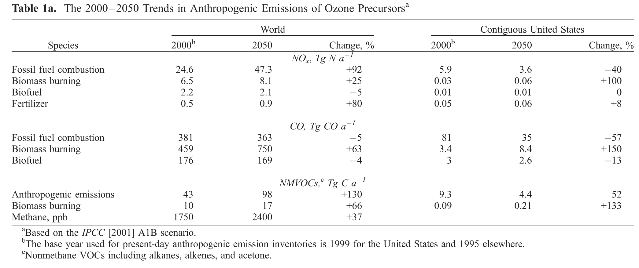
Methods
Case study - Methods

